Slide 1
Mobile Application Development
Lecture 14

Slide 2
Capacitor and Cordova
Till now, we have run our mobile app in the browser.
Esentially, we are building a web app using Ionic and Angular.
That’s why we’re previewing it in the browser all the time
Notes:
First of all, we need to understand what Parent, Child, and Sibling components are.

Slide 3
Capacitor and Cordova
We need to convert our Web App into a native App.
Native app means an app will work on iOS or Android (the platforms).
This is where Capacitor / Cordova comes in
Notes:
First of all, we need to understand what Parent, Child, and Sibling components are.

Slide 4
Capacitor and Cordova
Capacitor / Cordova convert your app into a native mobile app.
Once you add one of Capacitor / Cordova, you will be able to run it on your platform (Android or iOS).
Capacitor / Cordova basically create a native app which runs your Ionic app in a webView.
Remember, we discussed how Ionic app in run inside a webView. This is what it means.
Notes:
First of all, we need to understand what Parent, Child, and Sibling components are.

Slide 5
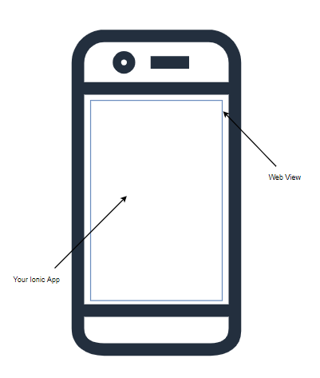
Capacitor and Cordova
Your native Mobile App on Android wrapped in a web View.
You won’t notice the difference.
Notes:
First of all, we need to understand what Parent, Child, and Sibling components are.

Slide 6
Capacitor and Cordova
Cordova was the only option when Ionic was introduced. You will see Ionic 2,3 projects using Apache Cordova but most Ionic 4 projects use Capacitor.
Capacitor has been built by the Ionic team and they strongly encourage using Capacitor over Cordova.
However, you can use cordova plugins alongside Capacitor so you have this flexibility.
Notes:
First of all, we need to understand what Parent, Child, and Sibling components are.

Slide 7
Capacitor and Cordova
There is much more to Capacitor / Cordova then just creating a native app.
So far, we have developed our ionic app in the browser. What if we wanted to add camera functionalities or access some other mobile device specific feature?
Again, that’s where Capacitor / Cordova come in.
Capacitor / Cordova provide us access to Native Platform APIs. (e.g Camera, Location, Storage).
Notes:
First of all, we need to understand what Parent, Child, and Sibling components are.

Slide 8
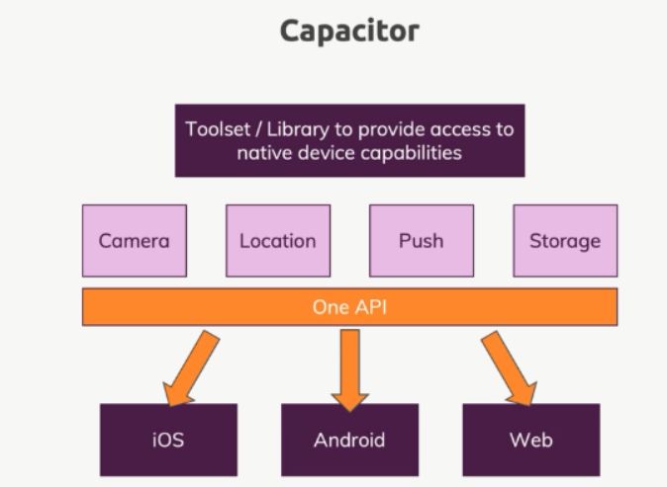
Capacitor and Cordova
We will focus mostly on Capacitor.
It provides us an API (JavaScript functions) which we can call to do specific tasks. For e.g Take a picture etc.
Capacitor then converts these based on the platform its building for.
Notes:
First of all, we need to understand what Parent, Child, and Sibling components are.

Slide 9
You dont have to know everything. You just have to find the right questions

Slide 10
Adding Capacitor to Ionic App
Pre-requisites
Android Studio (https://developer.android.com/studio)
Android Phone or use an Android Emulator
Notes:
First of all, we need to understand what Parent, Child, and Sibling components are.

Slide 11
Adding Capacitor to Ionic App
Follow these commands to add capacitor to an existing Ionic application
1. ionic integrations enable capacitor
2. npx cap init
3. ionic build
4. npx cap add android
5. npx cap open android
Notes:
First of all, we need to understand what Parent, Child, and Sibling components are.

